Slide 1

Flow Transaksi IST Transfer ke Bank lain dan Perkiraan Test Script untuk Pengetesannya
Created by
Ferisa Tri Putri Prestasi

Slide 2
A Transfer switch is a foundational element of all modern Transfer architectures. It’s a smart processing software that enables communication between a multitude of Transfer providers to process Transfers in the most efficient way possible.

Slide 3
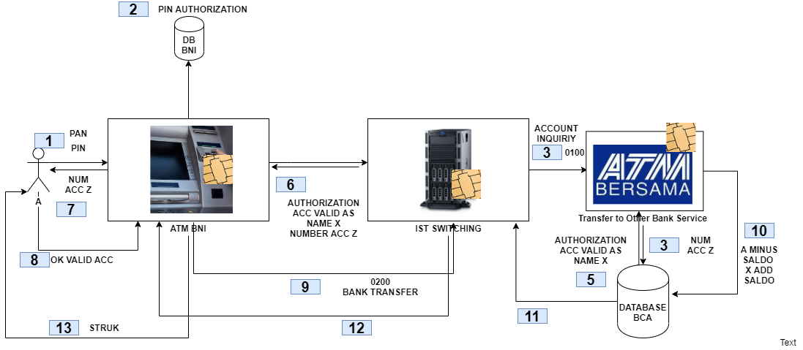

Slide 4
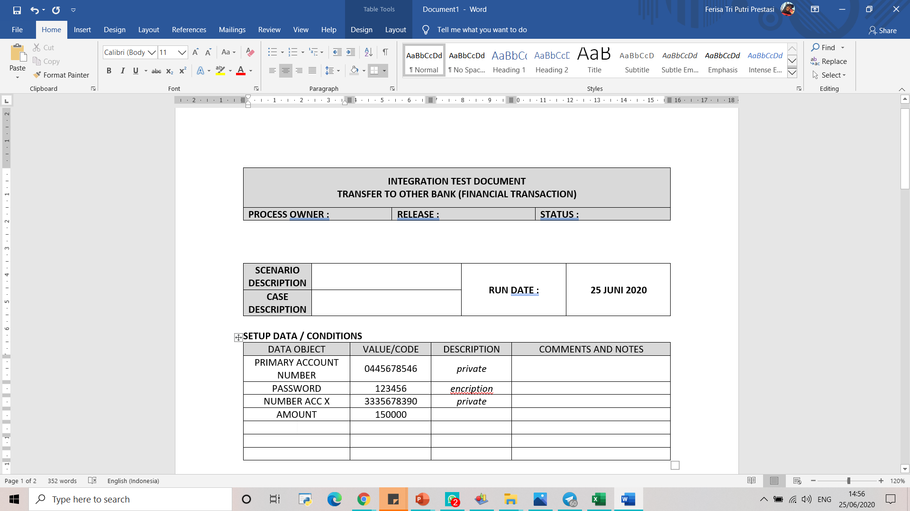

Slide 5
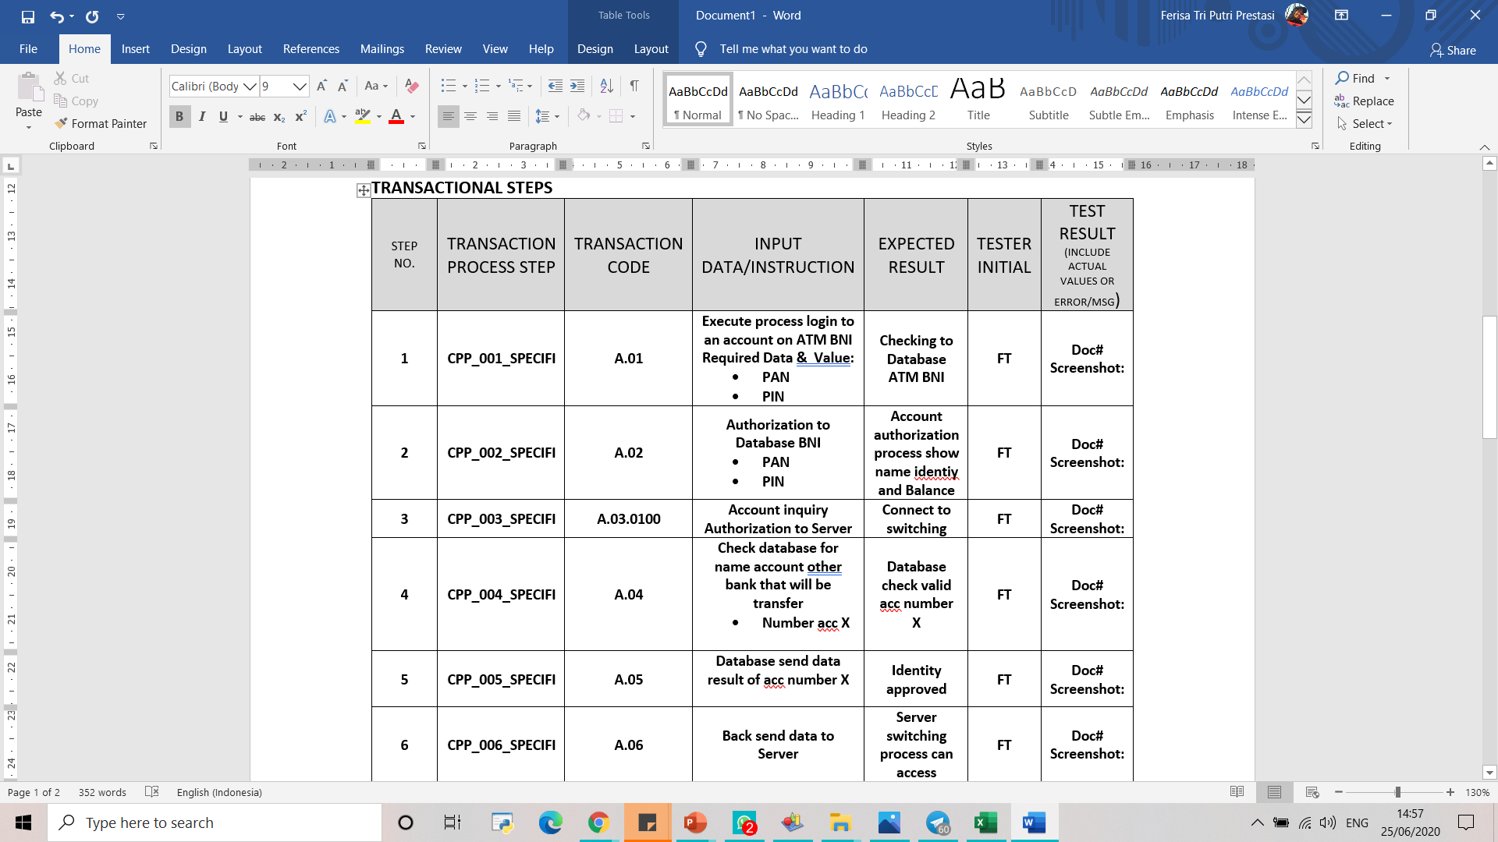

Slide 6
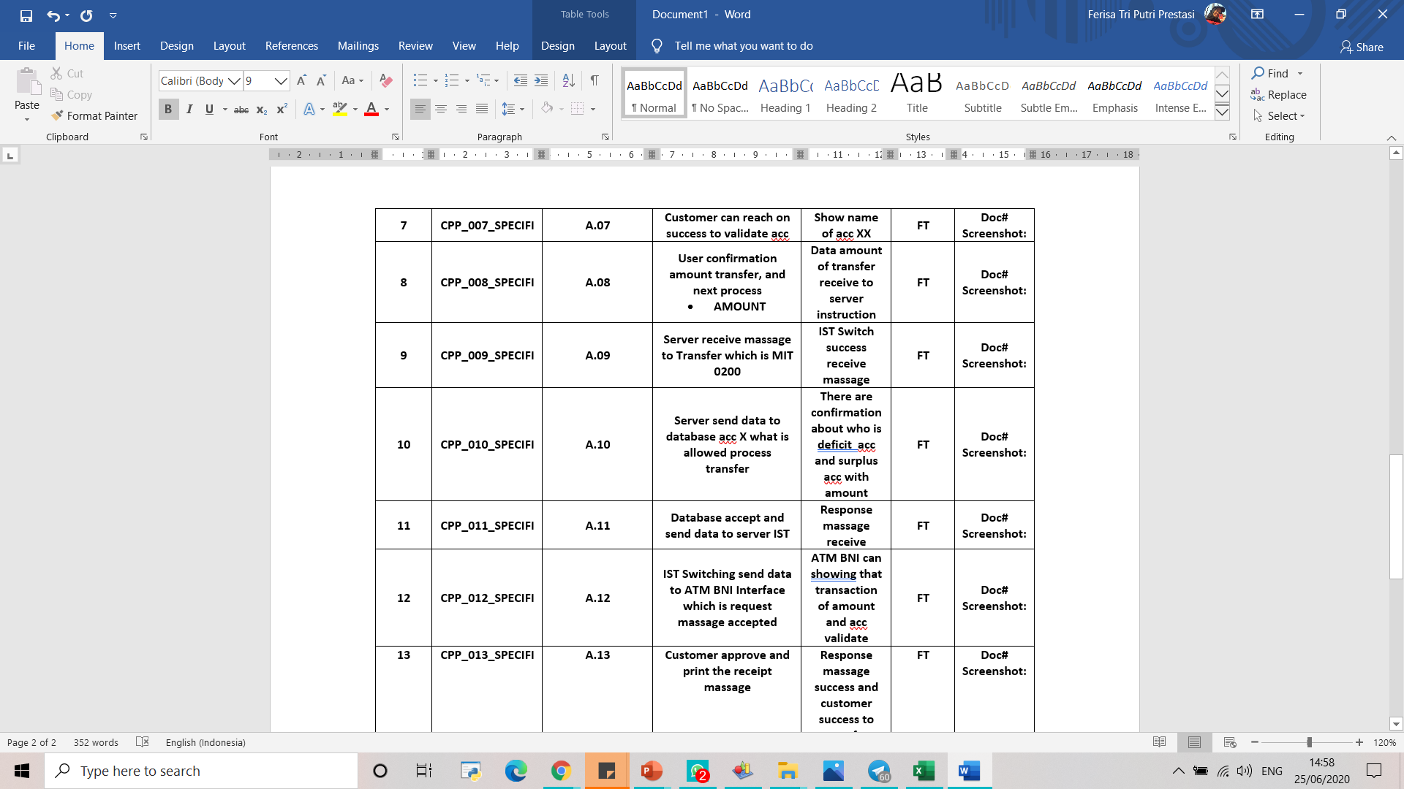

Slide 7
Thank you.

